Slide 1
Plagiarism Checker
(Using Cosine Similarity Algorithm)

Slide 2
Introduction
Plagiarism is intellectual property theft - it means presenting someone’s idea as your own. However, plagiarism goes beyond stealing other people’s work; you can also possibly plagiarize your own work.
On the internet, plagiarism is widespread.
The internet is brimming with content, which can be found on millions of different websites, it can be tough to tell which content is plagiarized and which is not at times.
Authors of blog postings should check to see if their work has been stolen or put elsewhere.
News organizations should investigate whether a content farm has stolen their news pieces and claimed them as their own.

Slide 3
How is it done?
You might be wondering how plagiarism detection on textual data is done, well it isn’t as complicated as you may think.
We all know that computers are good with numbers, so in order to compute the similarity between two text documents, the textual raw data is transformed into vectors => arrays of numbers and from that, we make use of basic knowledge of vectors to compute the similarity between them.

Slide 4
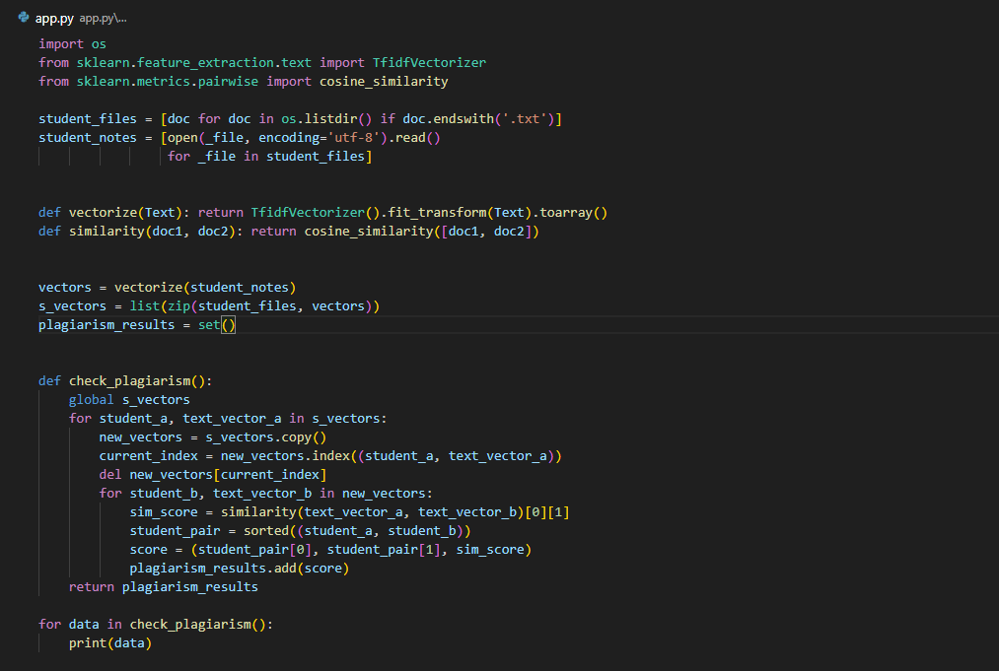
Code Except for this project

Slide 5
Main Objective
The general objective of this study was to develop a plagiarism checker prototype that detects similarities between textual data in text documents.
Specific Objectives
Educating about avoiding plagiarism. Introducing a plagiarism checker to students can spark conversations around plagiarism and its consequences inside and outside the classroom.
Helping to cite properly. A plagiarism checker can help students identify moments where they need to add or fix a citation.
Fostering writing skills and improving grammar.

Slide 6
Significance of the study
Intellectual Property Protection
Plagiarism checkers help protect others’ intellectual property by revealing if a written work, in part or as a whole, is similar to other works. This ensures that the rightful authors are credited and that their work isn’t used without proper citation and authorization.
Time-Saving
With this tool you don’t have to manually comb through the internet and compare your work with hundreds or thousands of other online literature. Instead, it will do it for you in a matter of seconds.
Information Verification
Another great thing about plagiarism checkers is they let you verify sources. If someone claims ownership of a piece of work, a plagiarism checker will let you easily verify this claim.

Slide 7
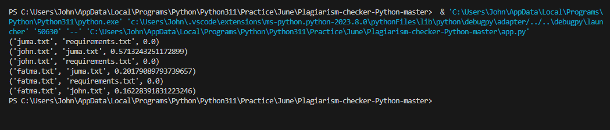
About Plagiarism Checker
It is relatively easy to use this program, to run this code you need to have your textual documents in your project directory with the .txt extension.
When you run the script, it will automatically load all the documents with that extension and then compute the similarities between them as shown below;

